Slide 1


Slide 2
About today…
String Concatenation
Retrieving characters
Slicing

Slide 3
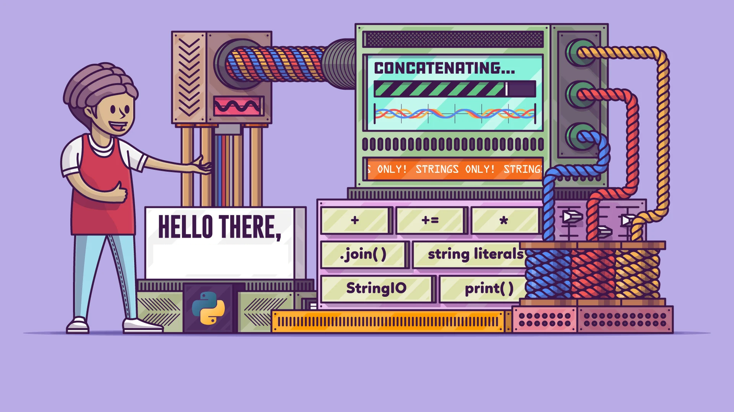
STRING CONCATENATION

Slide 4
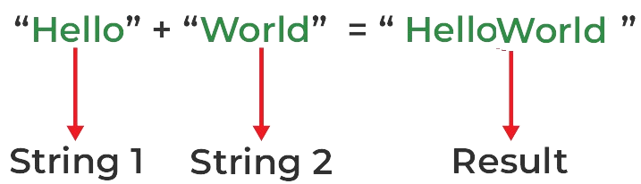
Definition
Process of combining two or more strings into a single string

Slide 5
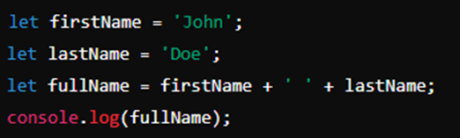
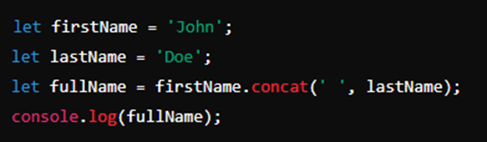
Methods
+
concat
John Doe
can take multiple arguments to concatenate strings
John Doe

Slide 6
What is the concept of String concatenation?
What are the different ways to concatenate strings?

Slide 7
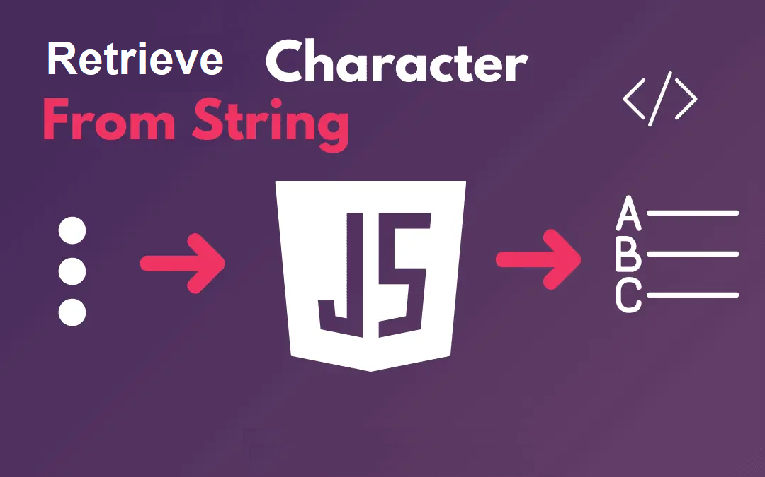

Slide 8
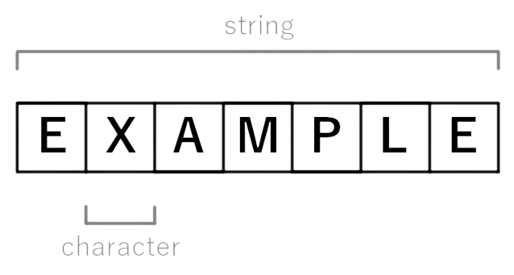
Definition
Accessing individual characters in a string

Slide 9


Methods
[ ]
charAt
H
W
H
W

Slide 10
What is the concept of Character retrieval?
What are the different ways to retrieve characters from string?

Slide 11


Slide 12
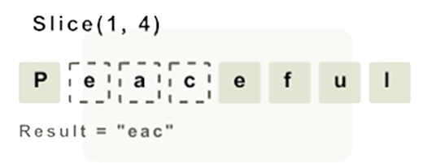
Definition
Extracting a portion of a string

Slide 13

Methods
slice()
World

Slide 14


Slide 15

Write a simple JavaScript program that demonstrates the naming variables as per conventions and demonstrate their scope.

Slide 16
Home Work
Practice
Variable naming
Variable scope
NEXT
JavaScript variables and naming conventions

Slide 17
Create an HTML page with a button that opens 3 alert messages getting user name and two numbers from the user and store those values in appropriate variables. Finally printing the message in the following format :
“Hi <user>, <firstnumber>+<secondnumber>=<result>"

